Slide 1
IPL ASSIGNMENT
File created on: 30-06-2021 11.00.38 PM

Slide 2
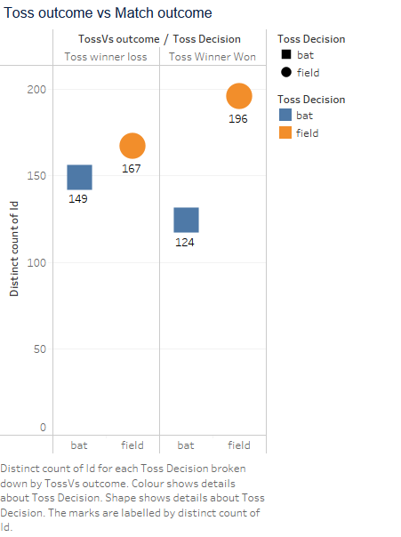
In ppt you can see that toss winner are choosing fielding 196 times

Slide 3
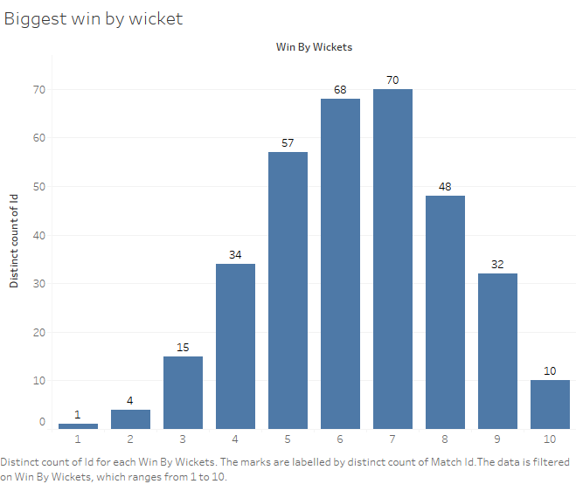
70 matches are won by 7 wickets(it is the maximum times)

Slide 4
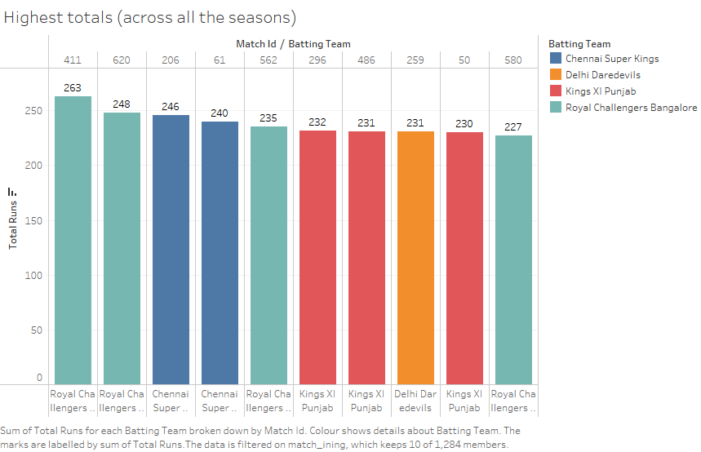

Slide 5
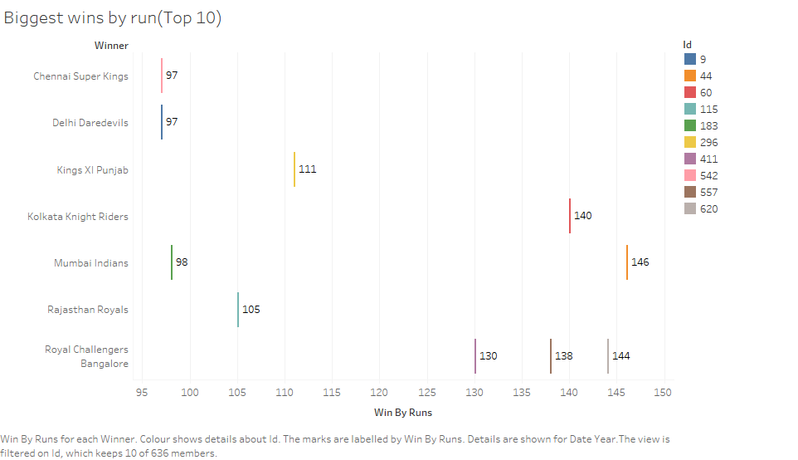
Chennai Super Kings has won maximum matches by run

Slide 6
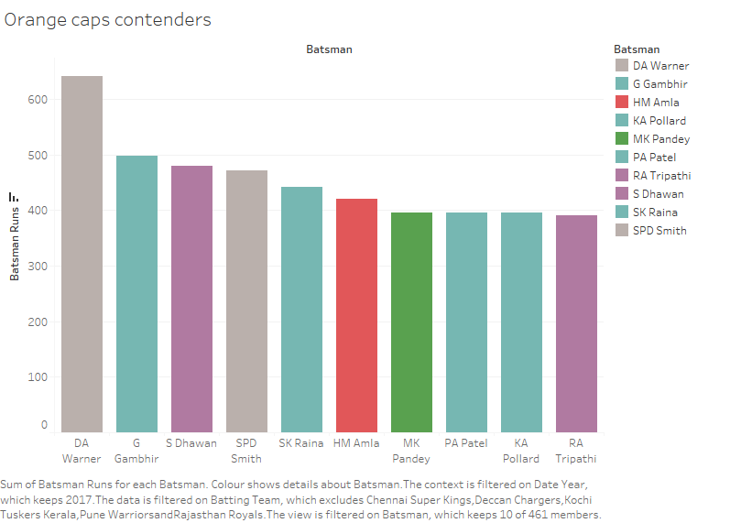
In year 2017 DA Warner won the orange cap( maximum runs in particular season by batsmen)

Slide 7
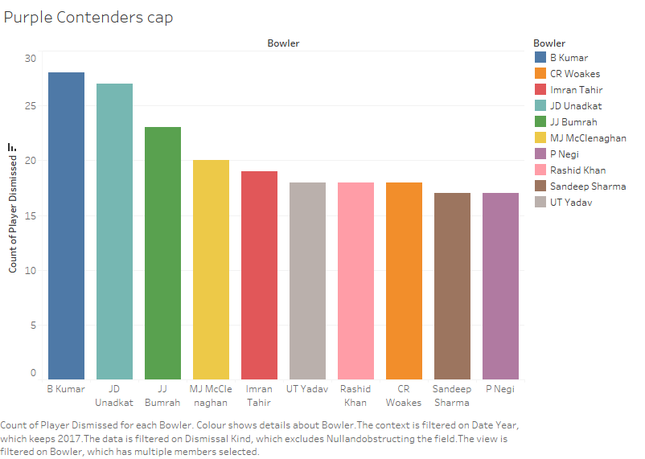
In Year 2017 , B Kumar won the Purple cap ( maximum wickets in particular season by bowler)

Slide 8
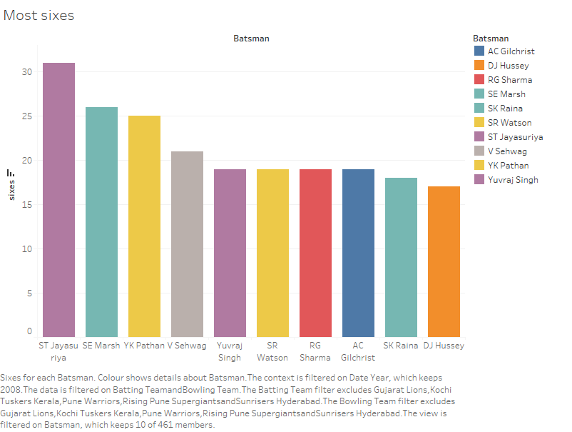
In Year 2008, Most sixes were done by ST Jayasurya

Slide 9
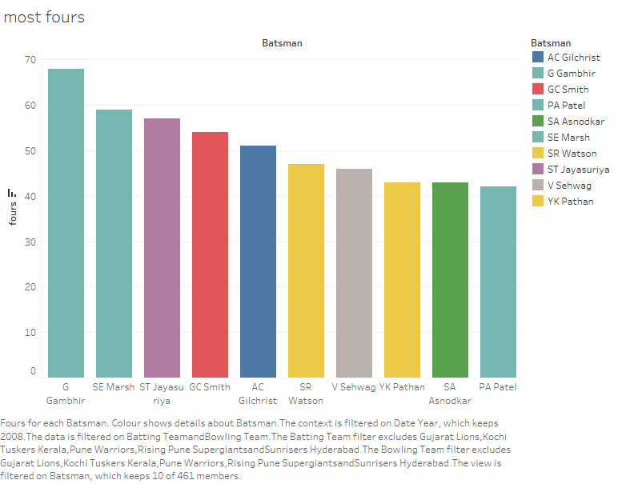
In Year 2008, Most four were done by G Gumbhir

Slide 10
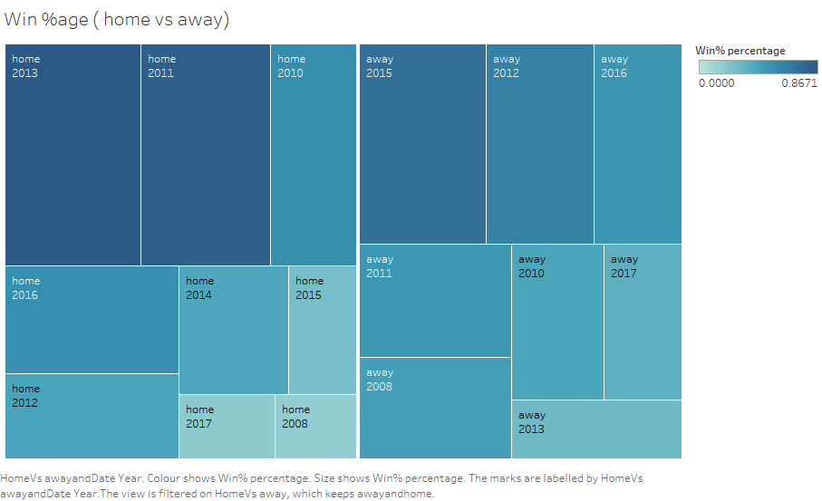
Maximum times Royal challenger Bangalore won the match when they are in home ground

Slide 12


